Slide 1


SMART PUBLIC RESTROOM
IOT_PHASE 3 PROJECT

Slide 2
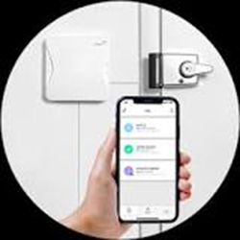
Phase 3 :Development part 1
INTRODUCTION:
Smart washrooms are among recent IOT solutions that are very soon to be implemented here and there. Such new generation restrooms are expected to significantly improve customer experience and employee well-being while also lower costs allocated to maintain equipment.
Here we‘ll going to see a simple simulation of a Smart public restroom that monitors the occupancy and provides through an LED

Slide 3
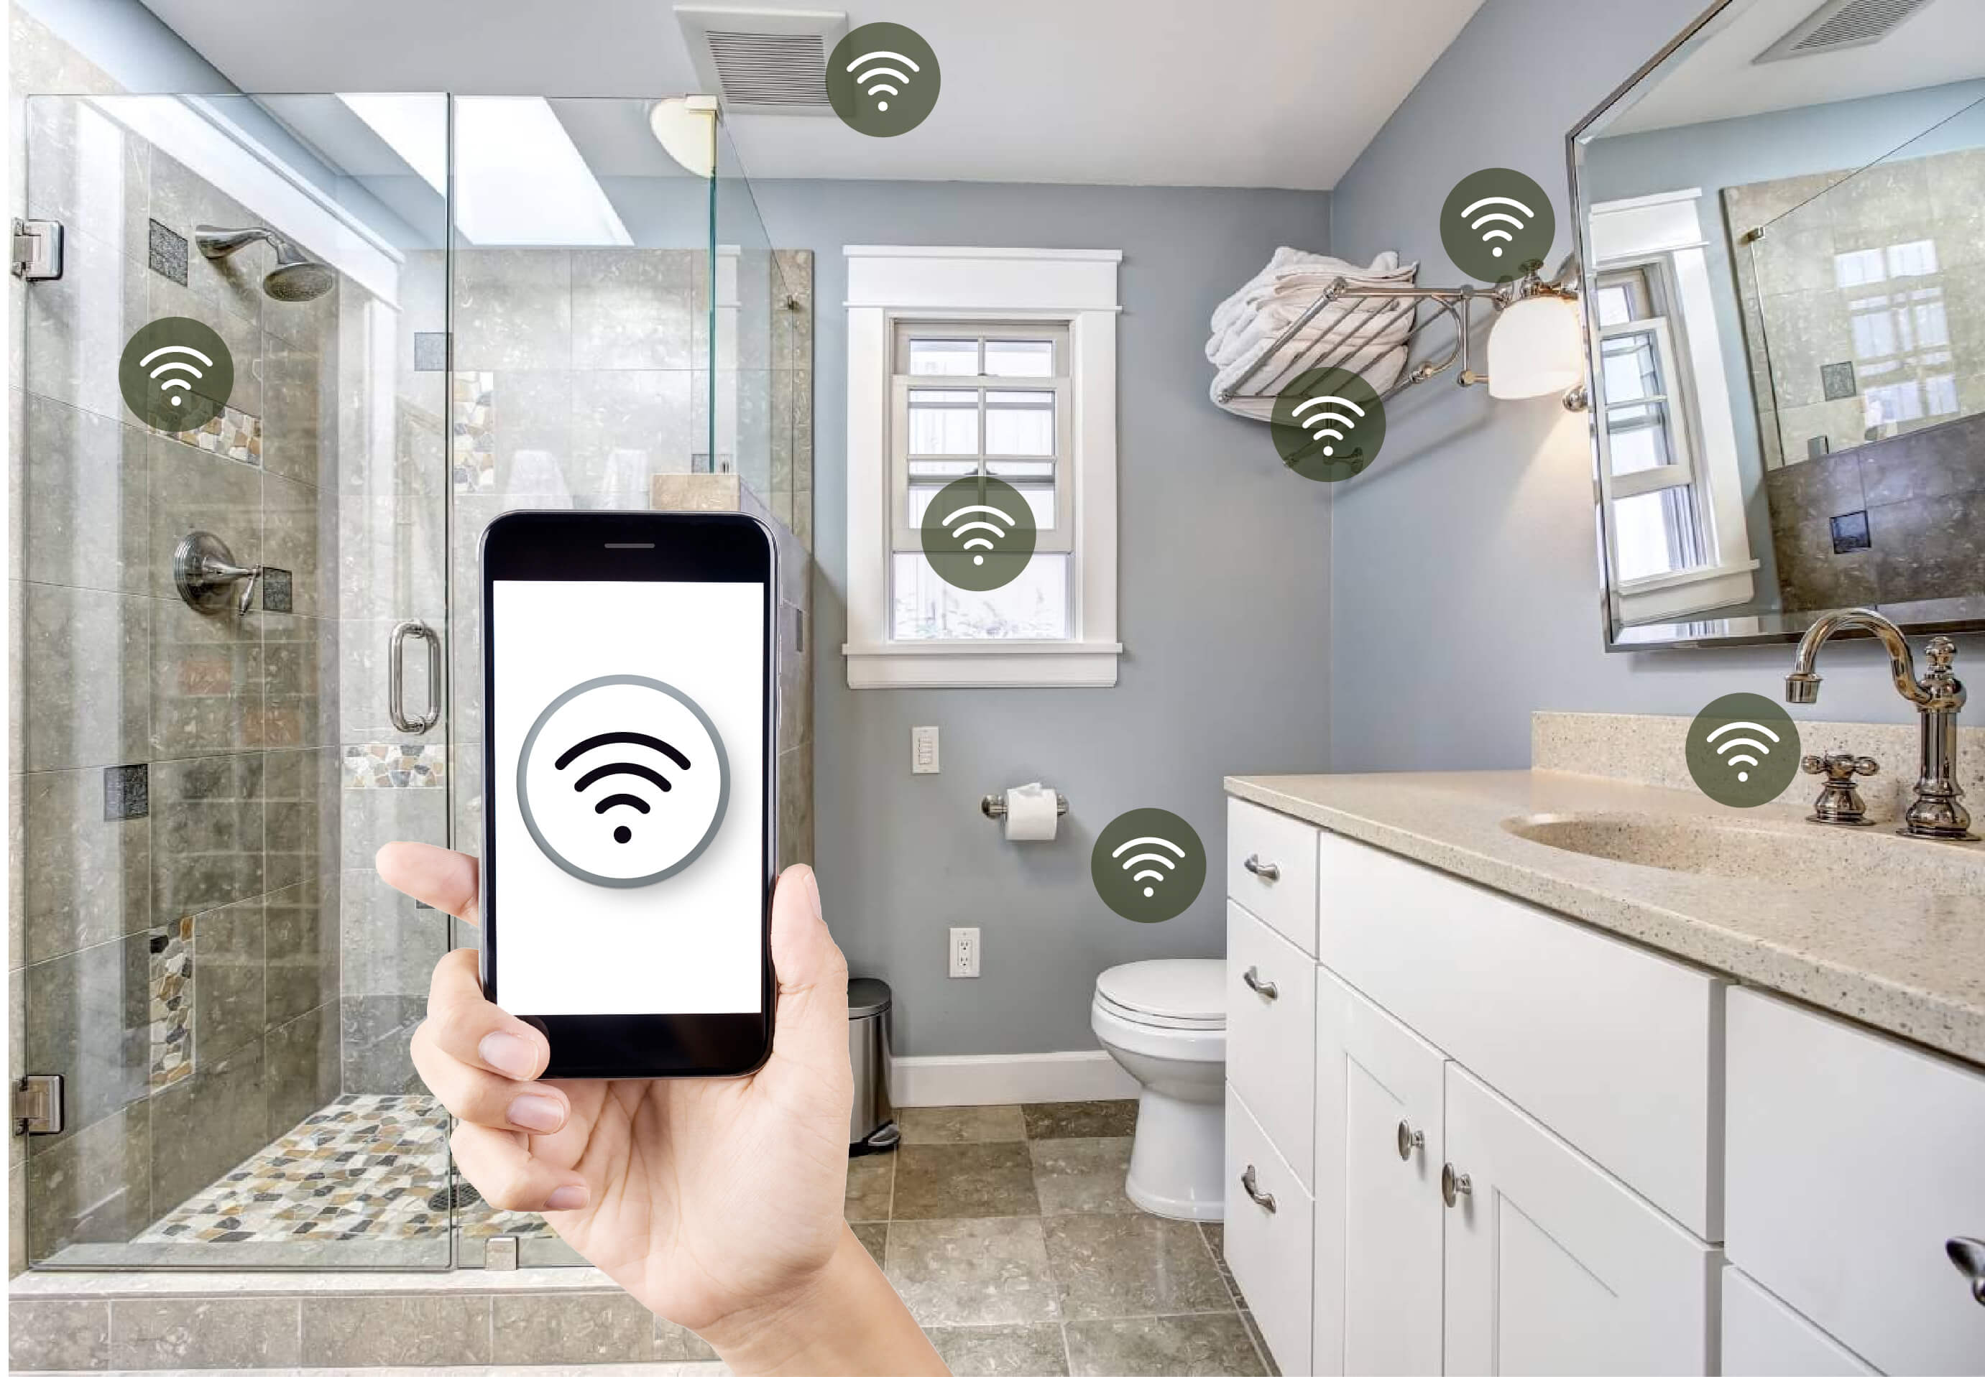
Components required:
1.Ardunio board :Ardunio uno
2.An LED to simulate the restroom occupancy indicator
3.A push botton to simulate the restroom door

Slide 4
Smart public restroom using wokwi simulator :
#include <Servo.h>
const int buttonPin = 4;
const int ledPin = 12;
const int servoPin = 9; // Digital pin for the servo
int buttonState = 1;
Servo doorServo;
void setup() {
pinMode(ledPin, OUTPUT);
pinMode(buttonPin, INPUT);
doorServo.attach(servoPin); // Attaching the servo to the pin
}
void loop() {
buttonState = digitalRead(buttonPin);

Slide 5
if (buttonState == HIGH) {
// Restroom is occupied
digitalWrite(ledPin, HIGH);
// Open the door (rotate the servo)
doorServo.write(90); // Angle to open the door
} else {
// Restroom is vacant
digitalWrite(ledPin, LOW);
// Close the door (return the servo to its initial position)
doorServo.write(0); // Angle to close the door
}
}

Slide 6
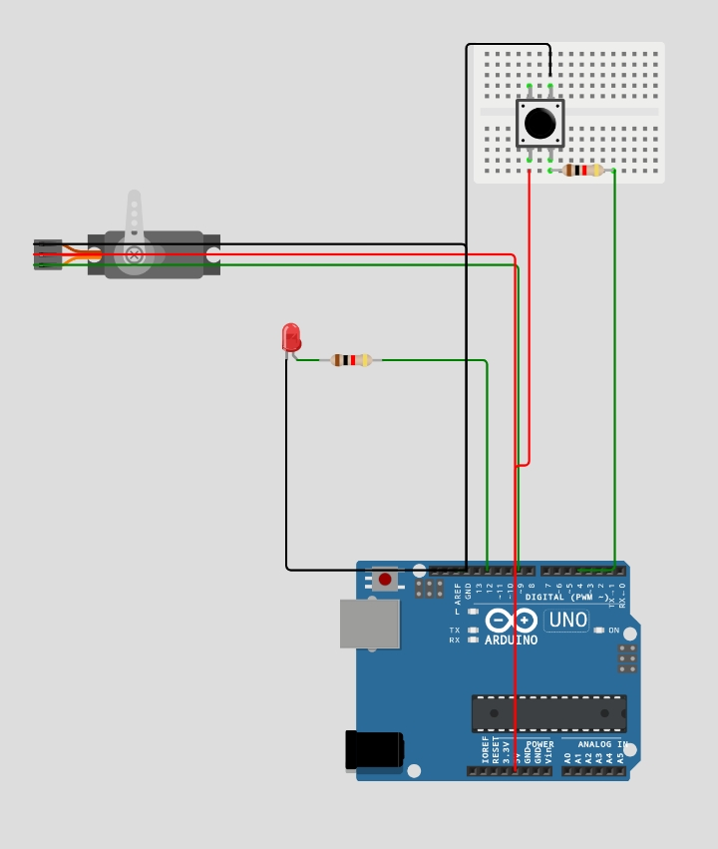
Output :

Slide 7
OUTPUT LINK in WOKWI:
https://wokwi.com/projects/378898578284772353

Slide 8
BENEFITS:
Number of complaints reduces.
Restroom users can easily feedback on any problems they spot.
Equipment is well-maintained due to real time data usage.

Slide 9

THANK YOU
By Team:
A.Anbuselvi
D.Arthi
S.Abirami
R.Abirami
C.Aarthi

